Slide 1
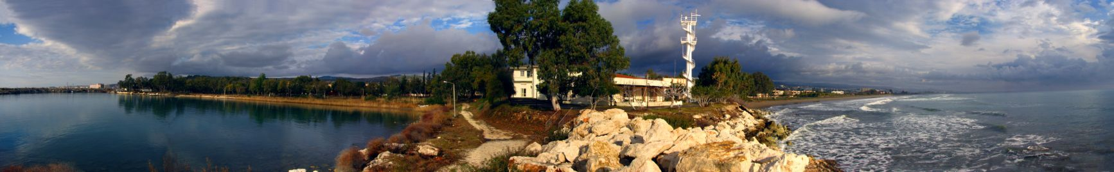



Strait Dynamics: A high-energy coastal ocean environment, types of behaviour, fluxes, energetics, impacts, based on case studies
Nonlinear Hydrodynamics of the Atmosphere and Ocean, with Examples from Sea Straits
Emin Özsoy¹, Adil Sözer¹, Özgür Gürses¹, Murat Gündüz¹, Gianmaria Sannino²
TURKISH NONLINEAR SCIENCE WORKING GROUP
"XIV. International Symposium on “Disorder Systems: Theory and Its Applications”
Mordoğan, İzmir 22 August 2014
(1) Institute Of Marine Sciences,
Middle East Technical University
Erdemli, Mersin, Turkey
(2) Italian National Agency For New Technologies,
Energy And Sustainable Economic Development
(ENEA-UTMEA), Rome, Italy

Slide 2
THE FUNDAMENTAL SOURCES OF NONLINEAR BEHAVIOR
LEADING TO “DISORDER” IN THE OCEAN AND THE ATMOSPHERE:
Hydrodynamics:
the (Navier-Stokes) equations of fluid dynamics are nonlinear
advection (~material derivative) , mixing, dissipation
nonlinear surface, bottom and lateral boundary conditions
inherent instabilities of motion, eddying and meandering
(wave instability,shear instability, static instability, diffusive-convective instabilities,
barotropic – baroclinic instability etc.)
transition to turbulence, fully developed turbulence = chaotic flow
nonlinear equation of state – ocean or atmosphere:
density=f(temperature, salinity) or density=(pressure, temperature)
Ecosystem dynamics:
coupled nonlinear or “reactor” equations
e.g. Lotka – Volterra predator-prey equations
systems with memory and delayed response
built on underlying physics, advection, diffusion, migration, swimming, clustering
turbulence interaction
e.g. orientation of zooplankton

Slide 3
PARTICULAR COMPLEXITY ISSUES AND CONSEQUENCES
IN THE OCEAN AND THE ATMOSPHERE:
Hydrodynamics:
“simple-looking” Navier-Stokes equations !
existence and uniqueness (smoothness) of solutions have not been proved!
(CLAY Mathematics Institute offers 1 million dollars for proof!)
- same eqns for ocean / atmosphere, with minor changes in physics, scales
wide span of exact solutions under simplified cases (full solution only numerical)
novel effects at geophysical scales due to earth’s rotation and density stratification
instabilities inherent
- leads to waves (surface, internal, topographic etc.) with unique propagation properties
- leads to gyres, eddies and meanders, at basin and sub-basin scales, internal / external
- leads to turbulence on local scales or geophysical turbulence at large scales
regular and inverse (from small to large scales) nonlinear cascading of energy
coherent structures and fronts emerge at local and geophysical scales
consequences on mixing at local and large scales, wind stirring, convection, upwelling
nonlinear equations of state – phase changes, ice physics, caballing etc. in the ocean
parameterization in models replaces physics at eddy-resolving scales
consequences on predictability
- typically 5 days in the ocean / atmosphere
- data assimilation in models
- ensemble modeling
Ecosystem dynamics: diversity, fragility, resilience, biogeochemical cycles built on physics

Slide 4
NONLINEAR PROCESSES, DISORDER, PREDICTABILITY:
Instability is a fundamental property of fluids that cannot be ignored or escaped !
waves, eddies, fronts, turbulence are essential components
nonlinear systems – sensitivity to initial conditions, divergence of solutions
the ‘butterfly effect’ !
significant loss of predictability in nonlinear coupled systems of high degrees of freedom
forecasting success limited to no more than ~ 5 days in atmosphere / ocean
‘open systems’: global versus limited area model forecasts
need external forcing or global closed budgets
with appropriate parameterizations in climate models it is possible to make longer term, climatic predictions, but with less confidence
partial solution with data assimilation
use of observations to update model forecasts
the Galilean ‘scientific method’: using observations along with models based on physics
importance of experiments:
http://mentalfloss.com/article/22913/hammer-and-feather-drop-moon
ensemble forecasting (ensemble of models, forecasts with varying ic and bc)
Bayesian statistics and Bayesian inference
update the probability estimate for a hypothesis as additional evidence is acquired

Slide 5

Clay Mathematics Institute 1 million $ prize !
for proof of uniqueness of solutions of the Navierf Stokes equations

Slide 6
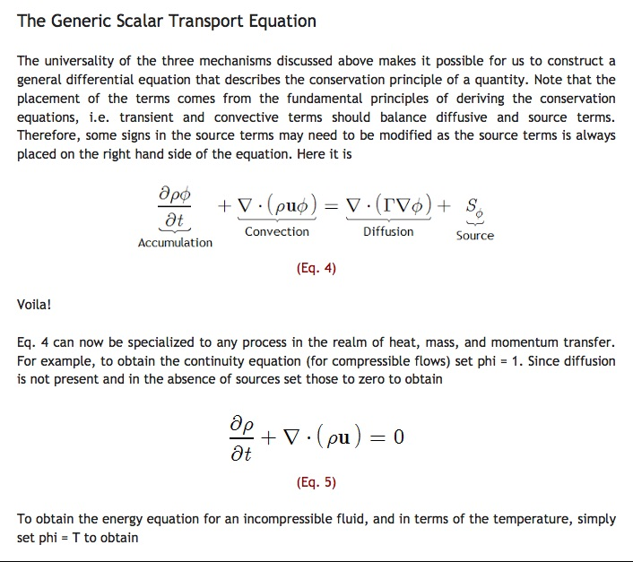

Slide 7
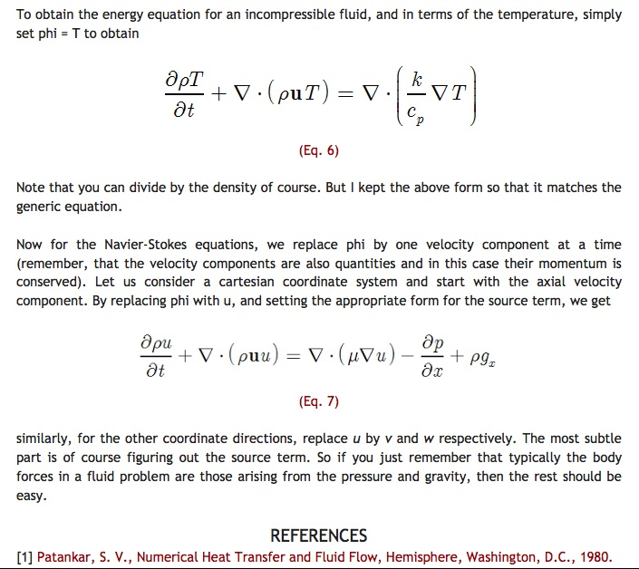

Slide 8

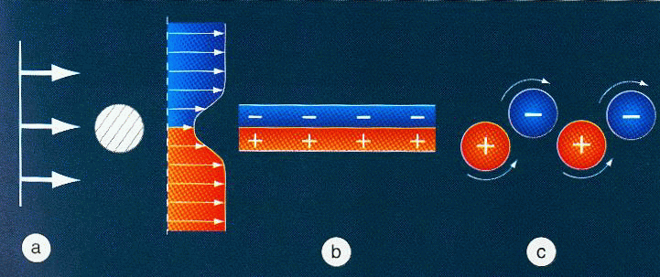
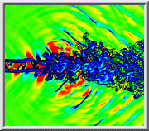
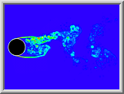
LABORATORY SCALE EDDIES AND JETS

Slide 9
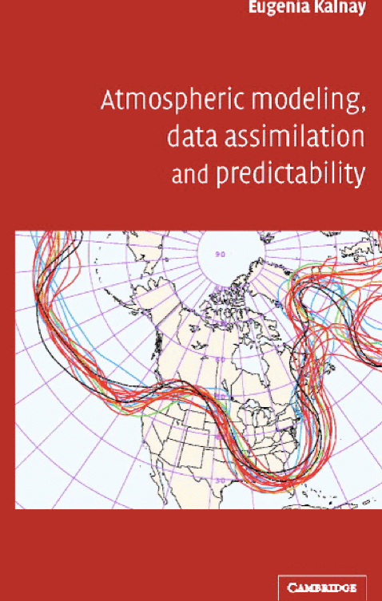
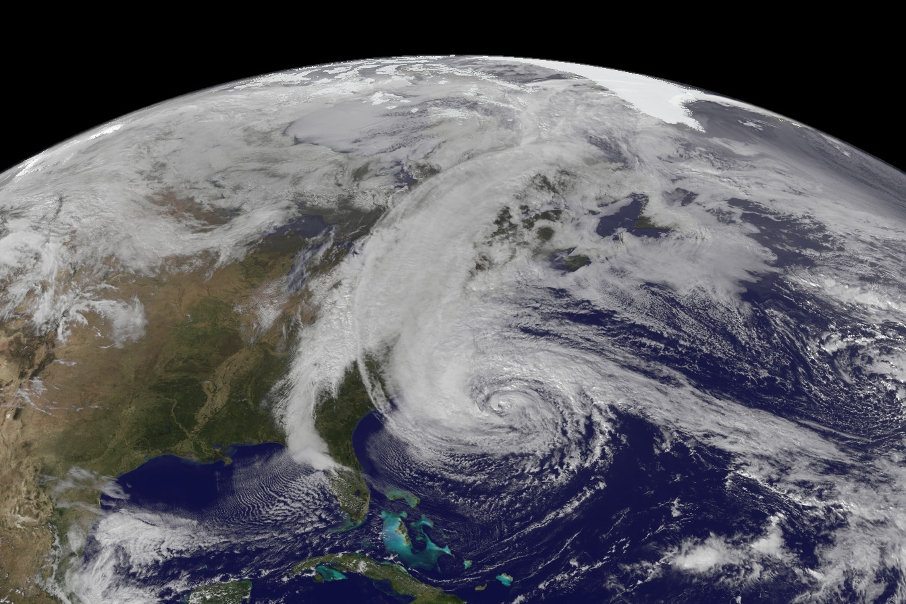
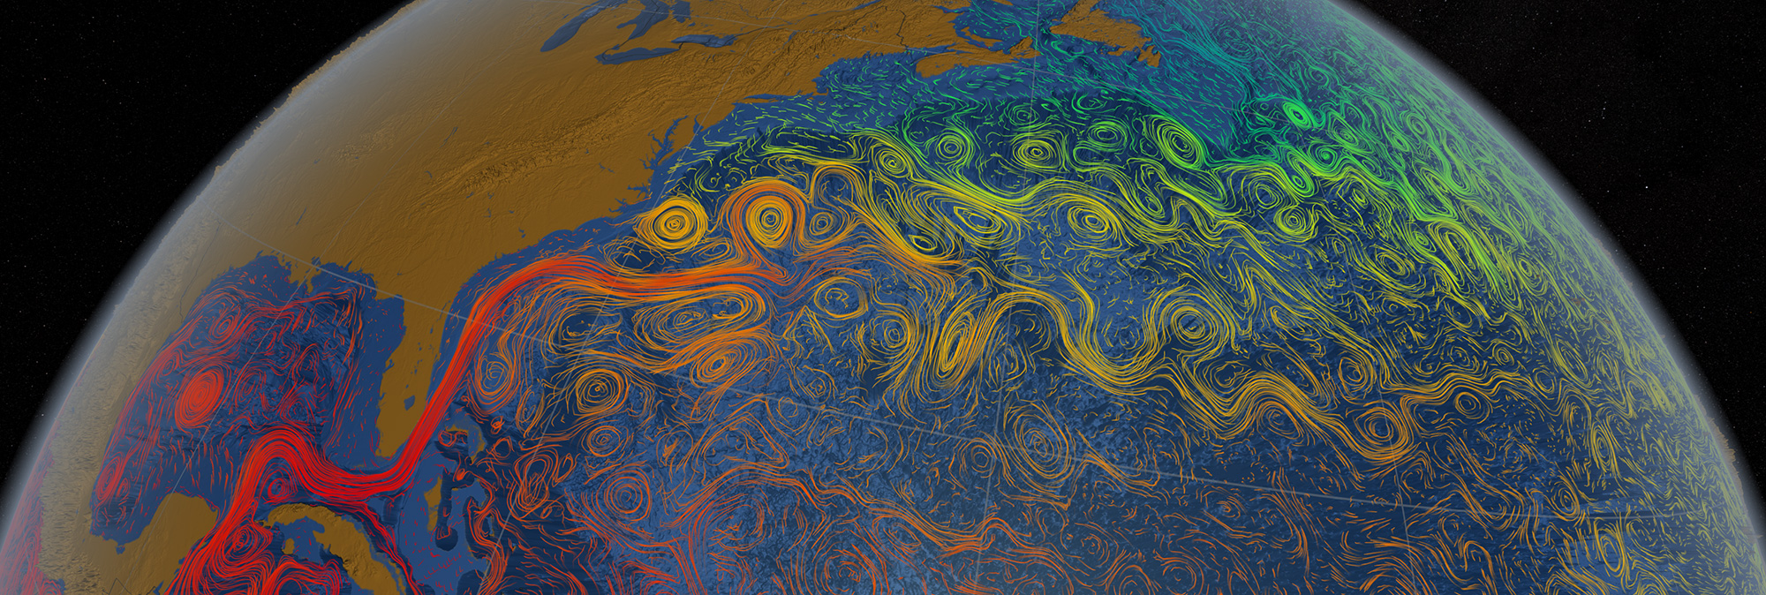
THE POLAR FRONT JET,
THE GULF STREAM
HURRICANE ‘SANDY’

Slide 10
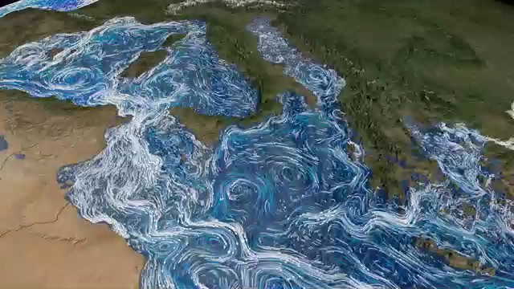
MEDITERRANEAN EDDIES AND JETS

Slide 11
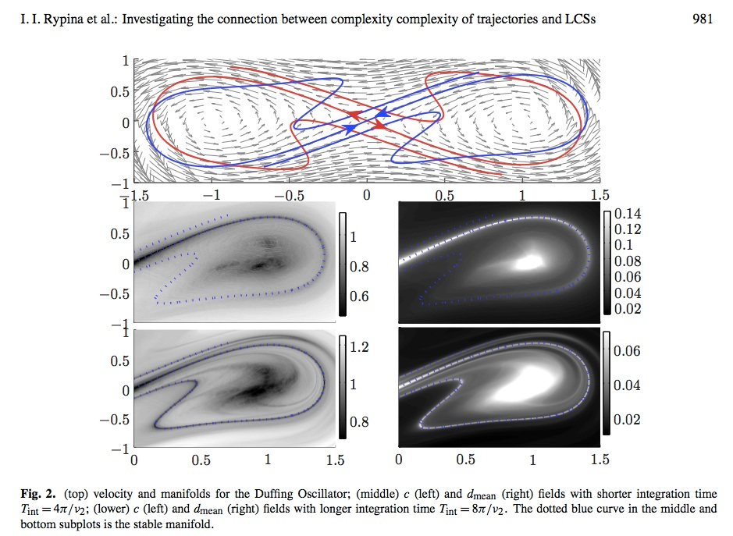
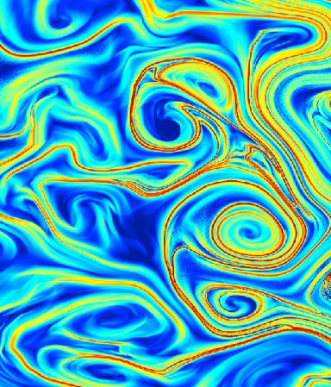
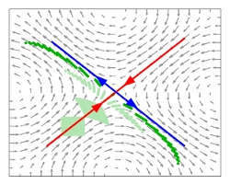
LAGRANGIAN COHERENT STRUCTURES (LCS)
Detection of
stable manifolds
Hyperbolic trajectories

Slide 12
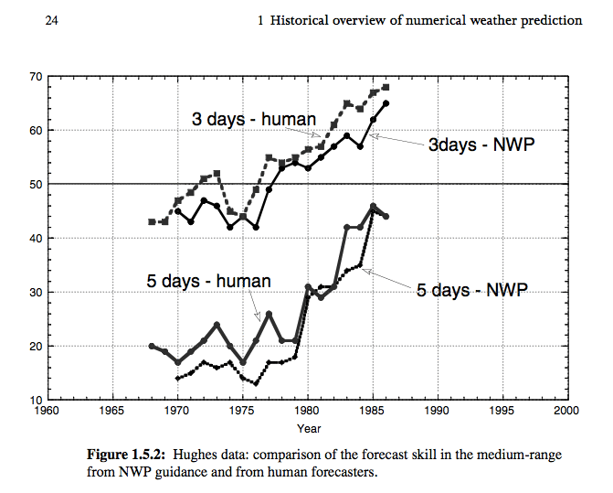
FORECAST SKILL INCREASE OVER THE YEARS

Slide 13

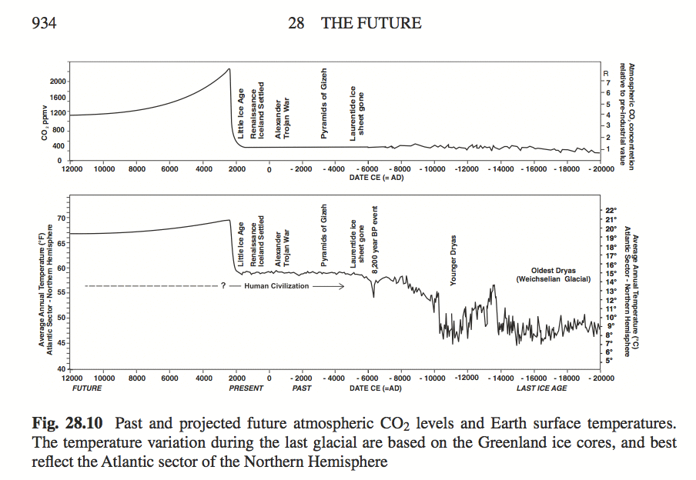
EARTH’S CLIMATE HISTORY

Slide 14
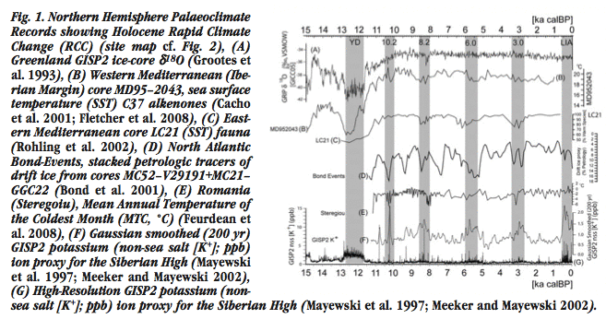
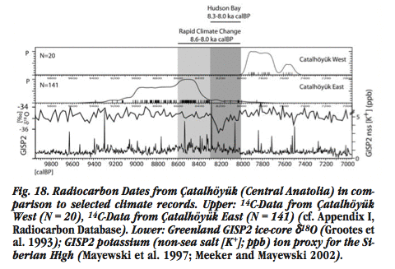
RAPID CLIMATE CHANGE
(RCC)
IN THE EASTERN
MEDITERRANEAN
(Weninger et al., 2009)
ÇATALHÖYÜK

Slide 15
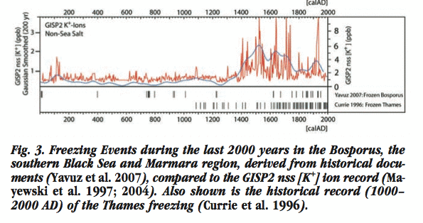
RAPID CLIMATE CHANGE
(RCC)
IN THE EASTERN
MEDITERRANEAN
(Weninger et al., 2009)
BOSPHORUS FREEZING EVENTS
LITTLE ICE AGE
15th – 16th
centuries AD

Slide 16


Slide 17
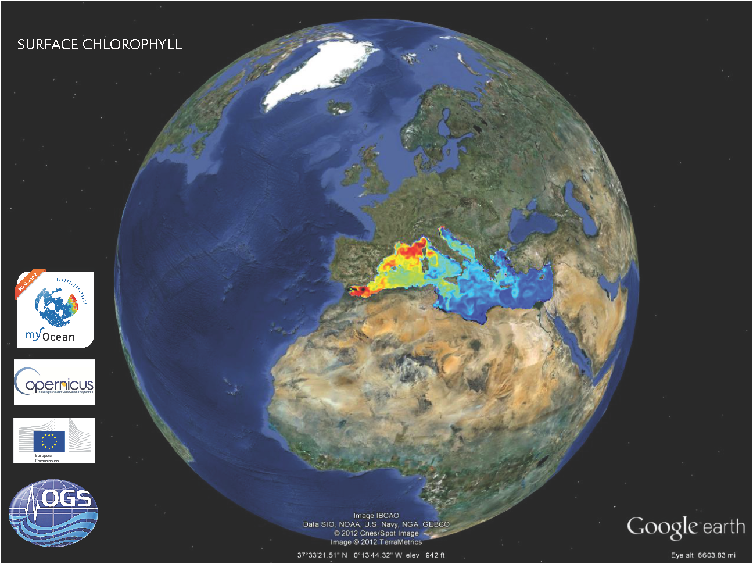

Slide 18
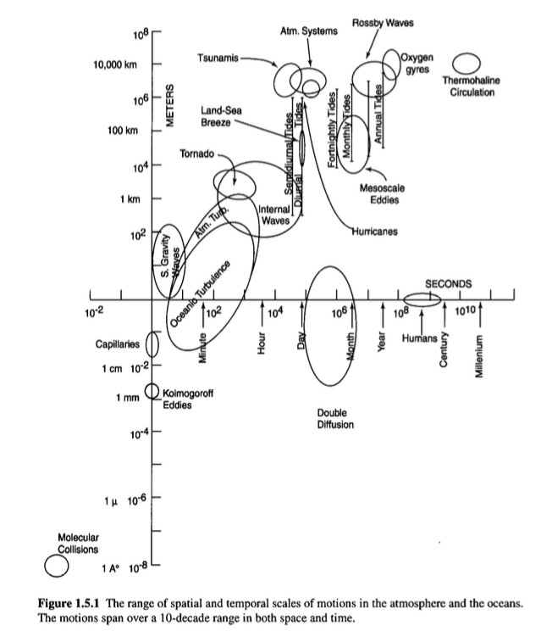

Slide 19
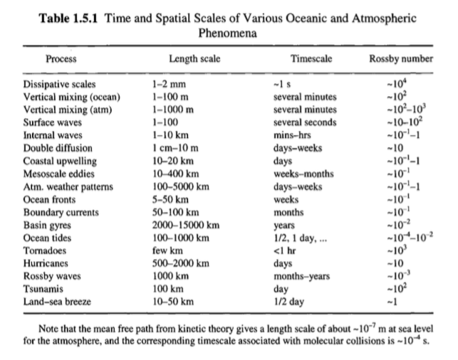

Slide 20
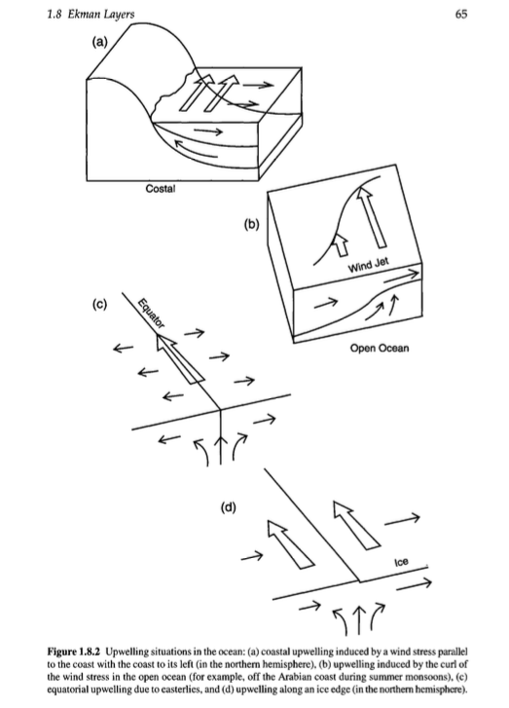

Slide 21
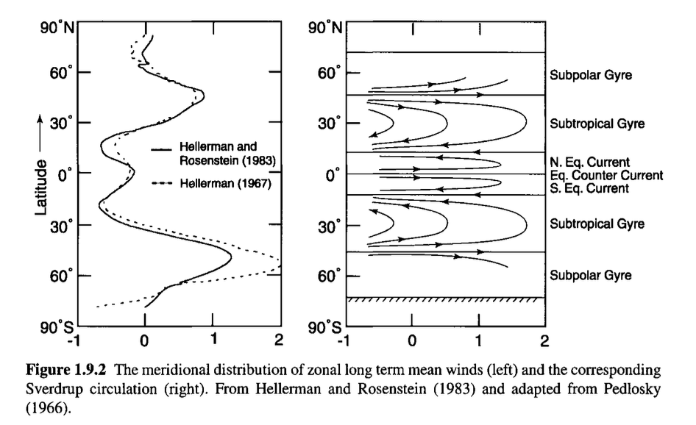

Slide 22
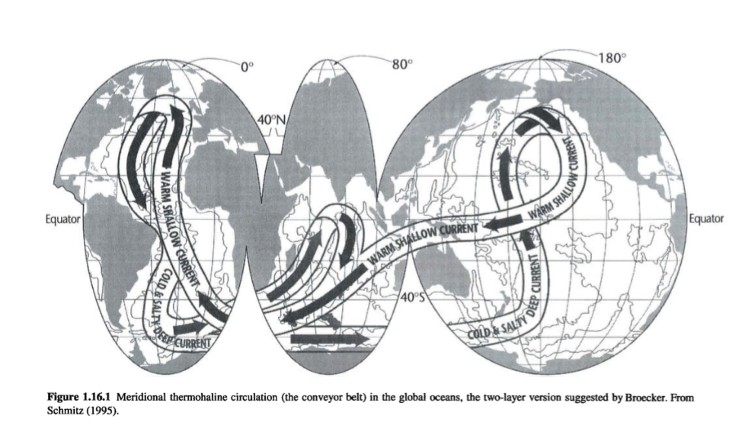

Slide 23
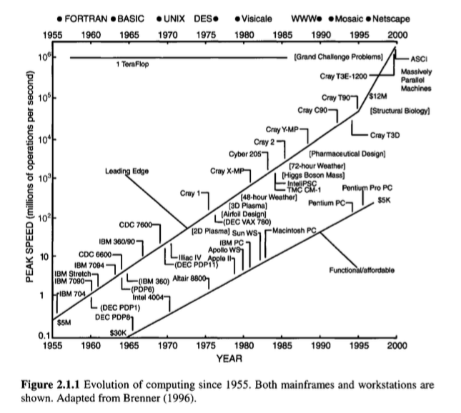

Slide 24
SEA STRAITS
BOSPHORUS AND DARDANELLES STRAITS IN PARTICULAR
Sea straits constitute complex, high-energy physical environments with rapid currents, hydraulic transitions, stratification and turbulence, and are controlled strongly by geometric constraints, often creating complex multi-scale interactions influencing the states of the interconnected basins. A wide range of coupled motions at scales extending from short-term to climatic co-exist and interact in sea straits and their adjacent basins.

